Slide 1
Natural Language Processing
Unit 6 Lexical databases and knowledge graphs
Faizan Javed
DataScience @ SMU

Slide 2
Lexical Knowledge Bases
Organize words into senses
Link those senses via relations such as :
Synonym/antonym: a word or phrase that means exactly or nearly the same as another word or phrase in the same language.
E.g., USA, America
Hyponym/hypernym: Hyponymy shows the relationship between a generic term (hypernym) and a specific instance of it (hyponym).
Holonym/meronym (whole-part):
the relationship between a term denoting the whole and a term
denoting a part of, or a member of, the whole.
E.g., Tree → bark, trunk, limb

Slide 3
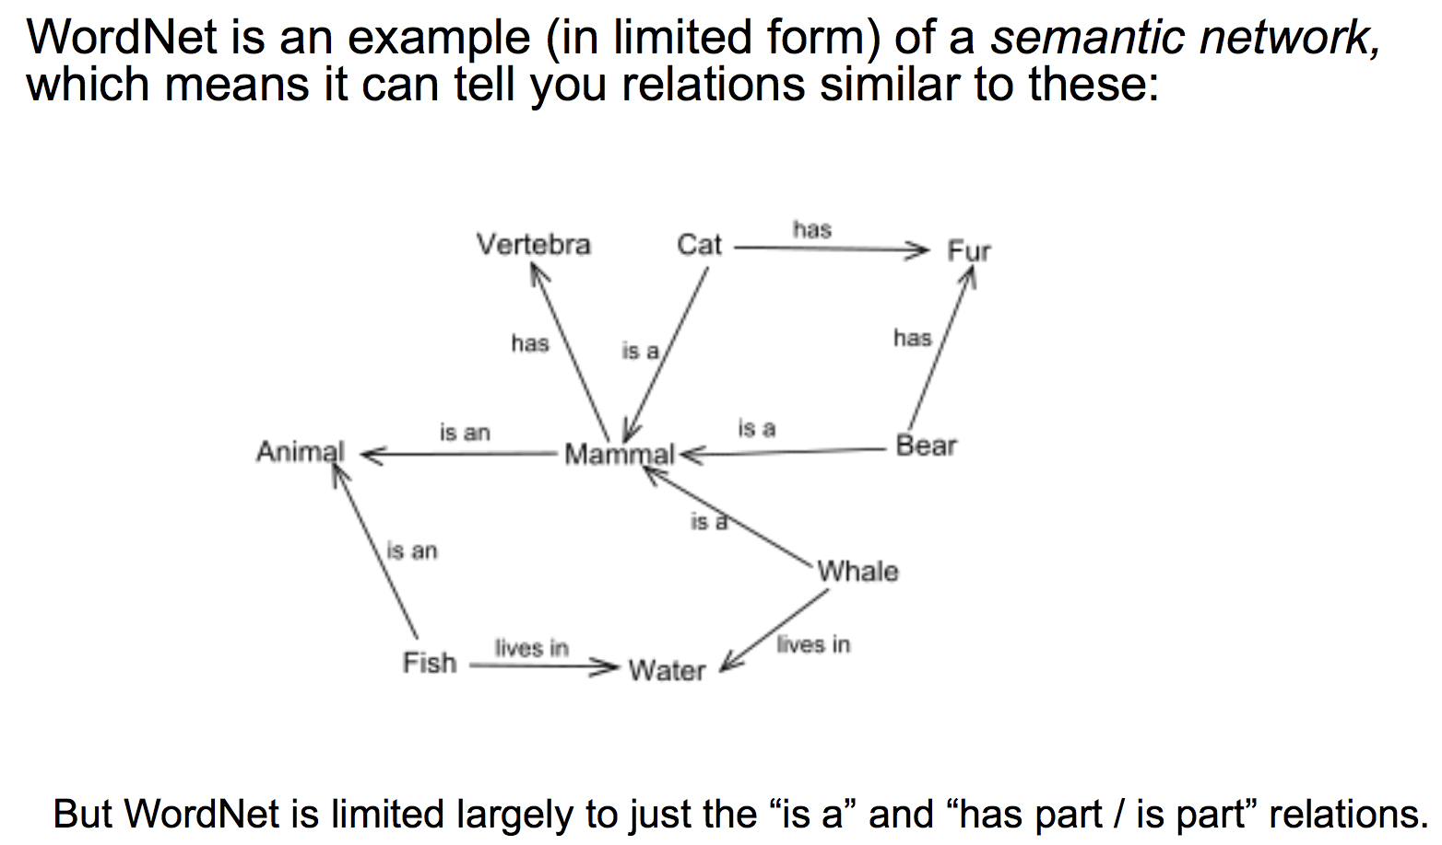
WordNet

Slide 4
Taxonomies and Ontologies
Taxonomy
Hierarchical organization of entities.
Parent-child “is-a” relationships
Ontology
Arbitrary complex relationships between entities.
Is-a, has-a, uses-a .. non-hierarchical relationships

Slide 5
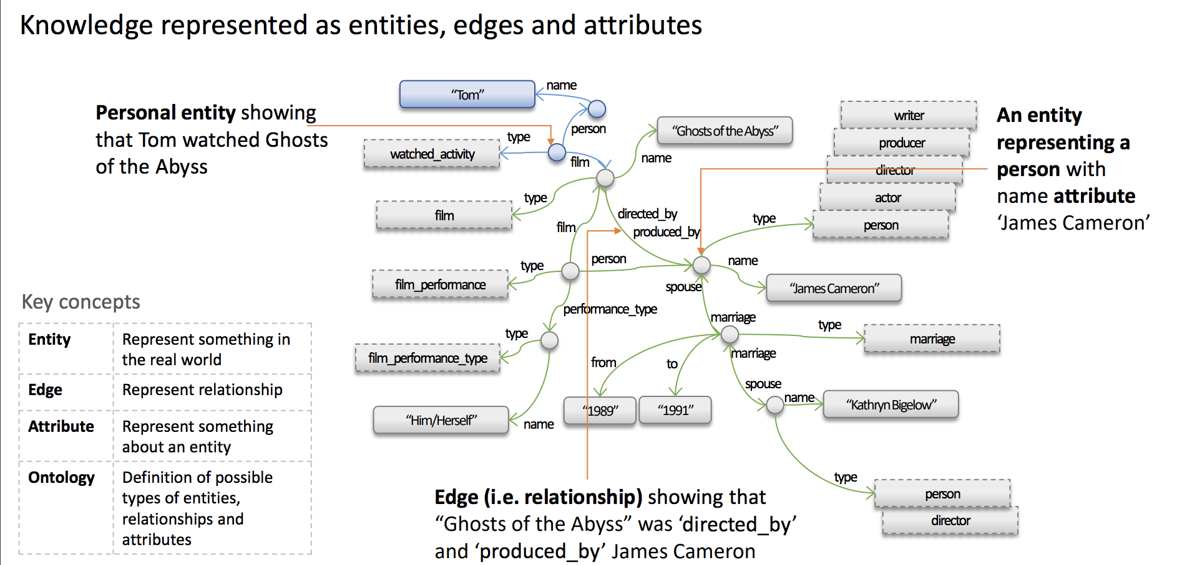
Knowledge graphs KDD-2018 tutorial https://kdd2018tutorialt39.azurewebsites.net/

Slide 6
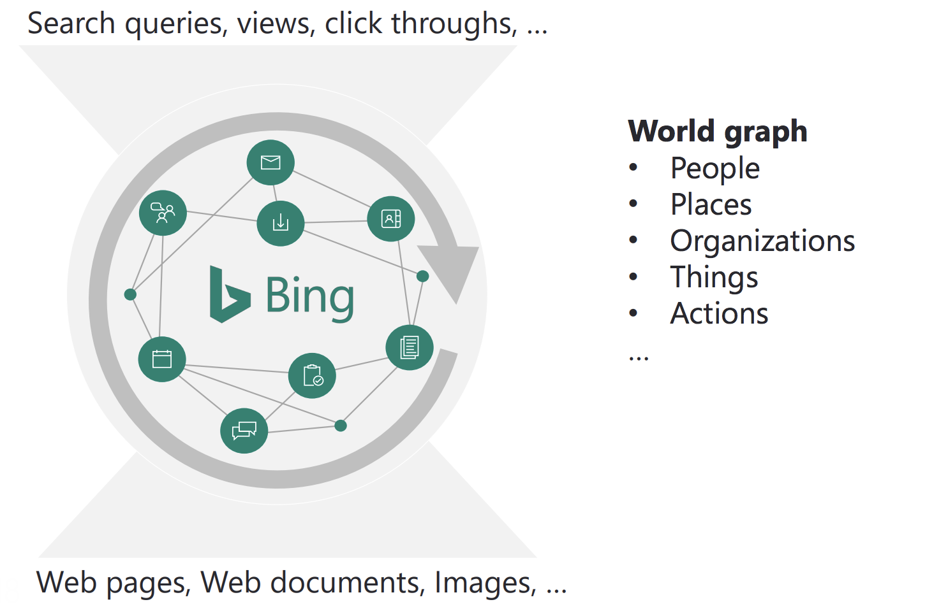
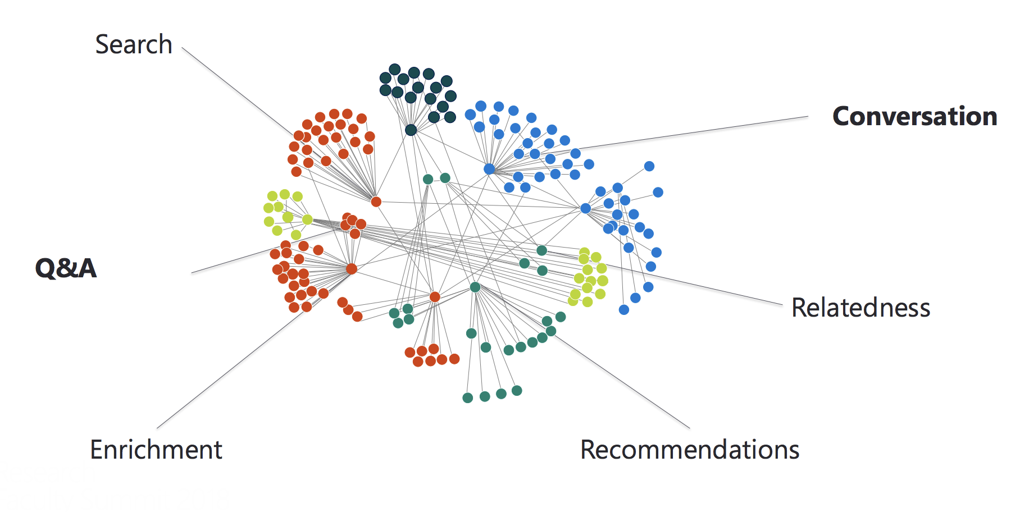
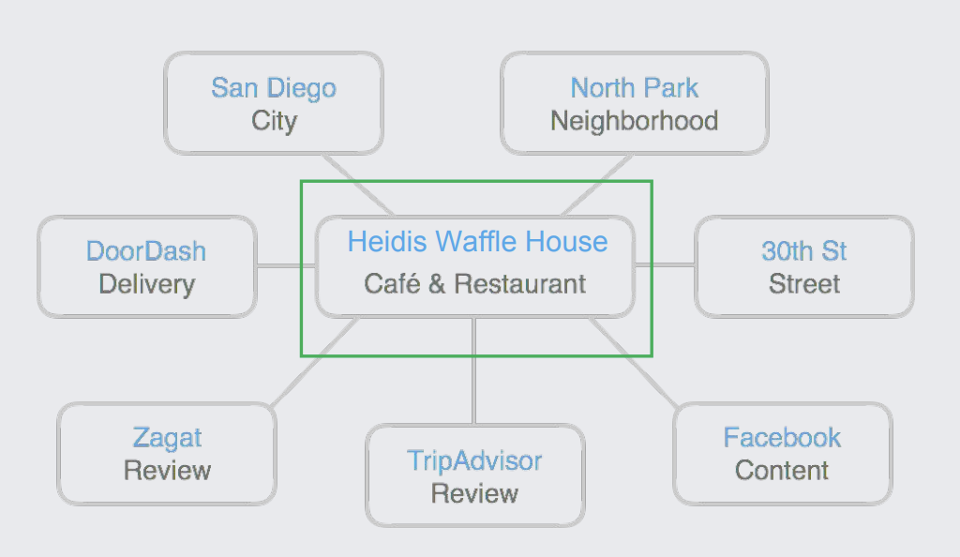
Knowledge graphs in industry

Slide 7
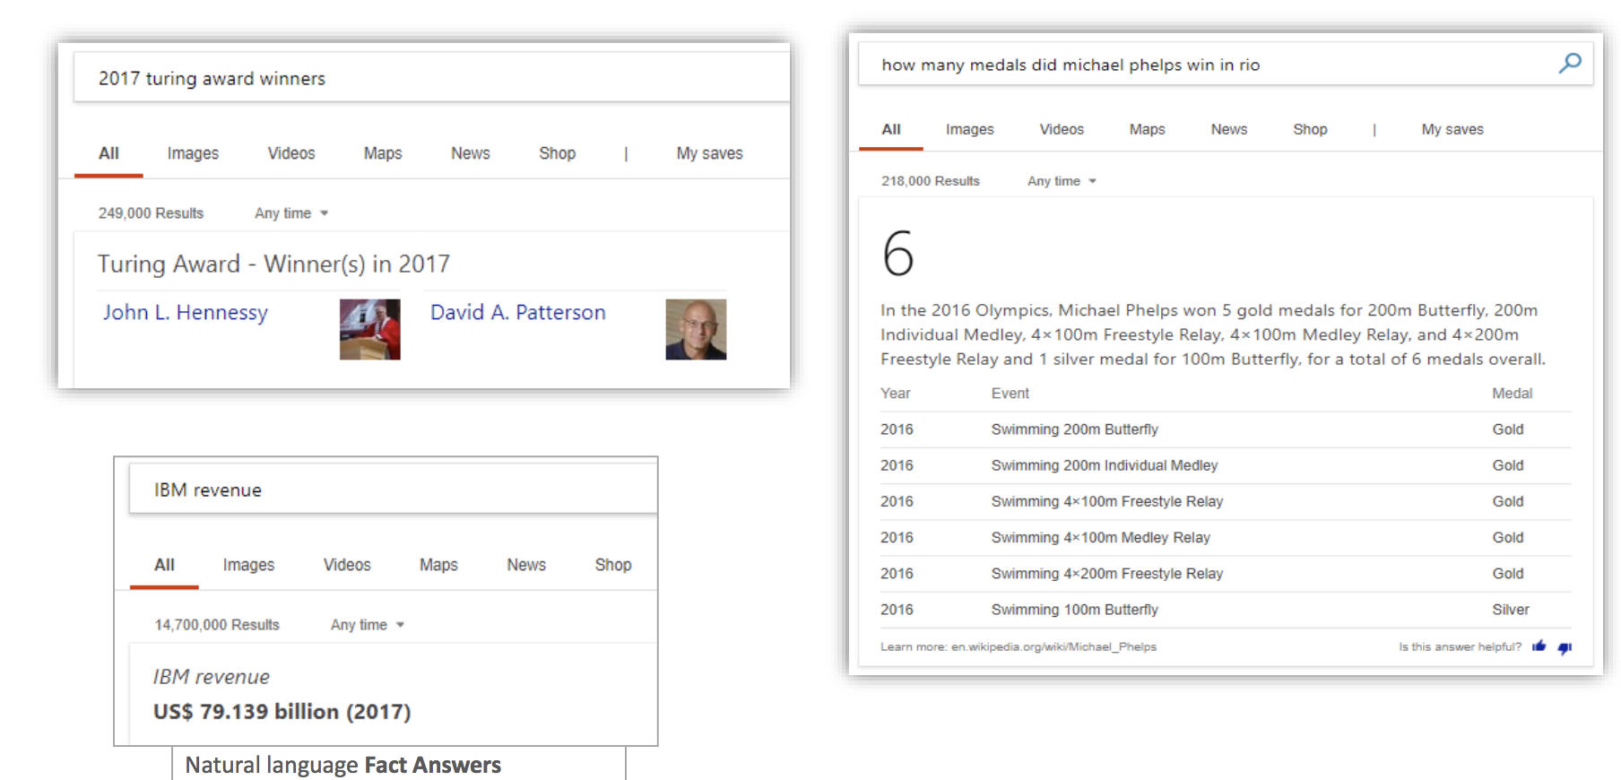
Knowledge Graph use cases

Slide 8
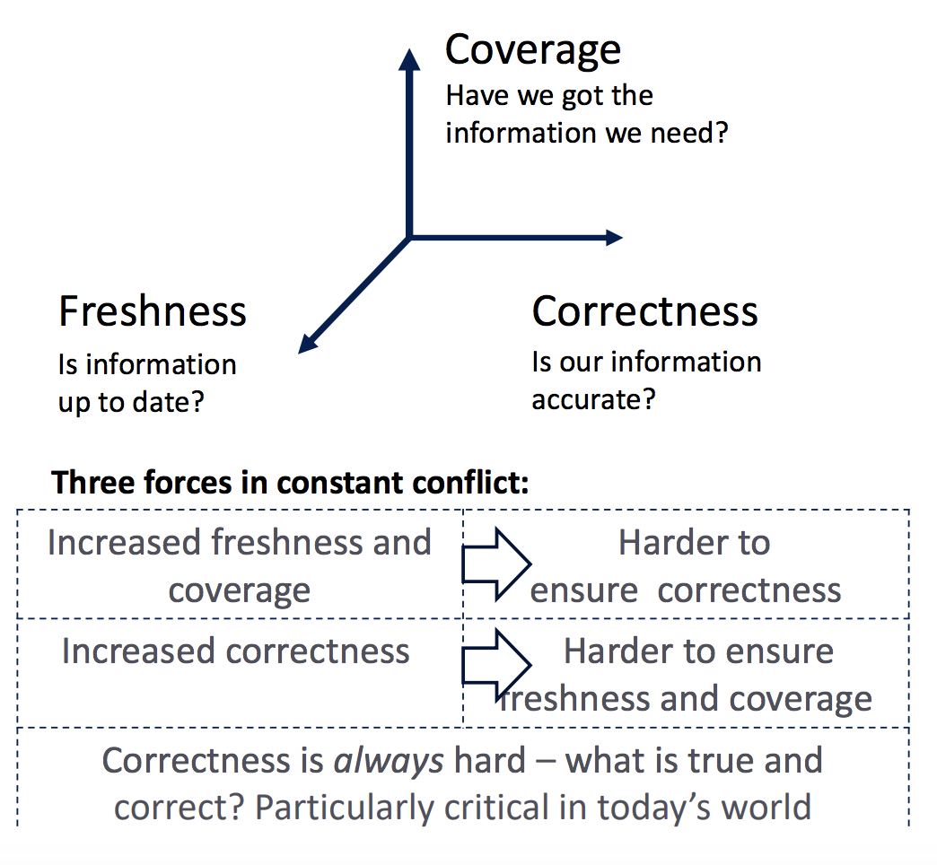
Knowledge Graph challenges
Notes:
Iswc 18: http://iswc2018.semanticweb.org/panel-enterprise-scale-knowledge-graphs/index.html

Slide 9
Uber Eats knowledge graph & query understanding https://eng.uber.com/uber-eats-query-understanding/
Help customers find the exact food/restaurant they want - What is the customer looking for?
What is the customers intent with the following queries?
“bubble tea”, “Asian”, “Indian”, “Hong Kong Grand Buffet”
Customer searches for “udon”, but orders “soba” – what insights can you get from this?
User experience: what if the customer is searching for “Hong Kong Grand Buffet” but its not in their delivery area?

Slide 10
Uber Eats knowledge graph & query understanding https://eng.uber.com/uber-eats-query-understanding/

Slide 11
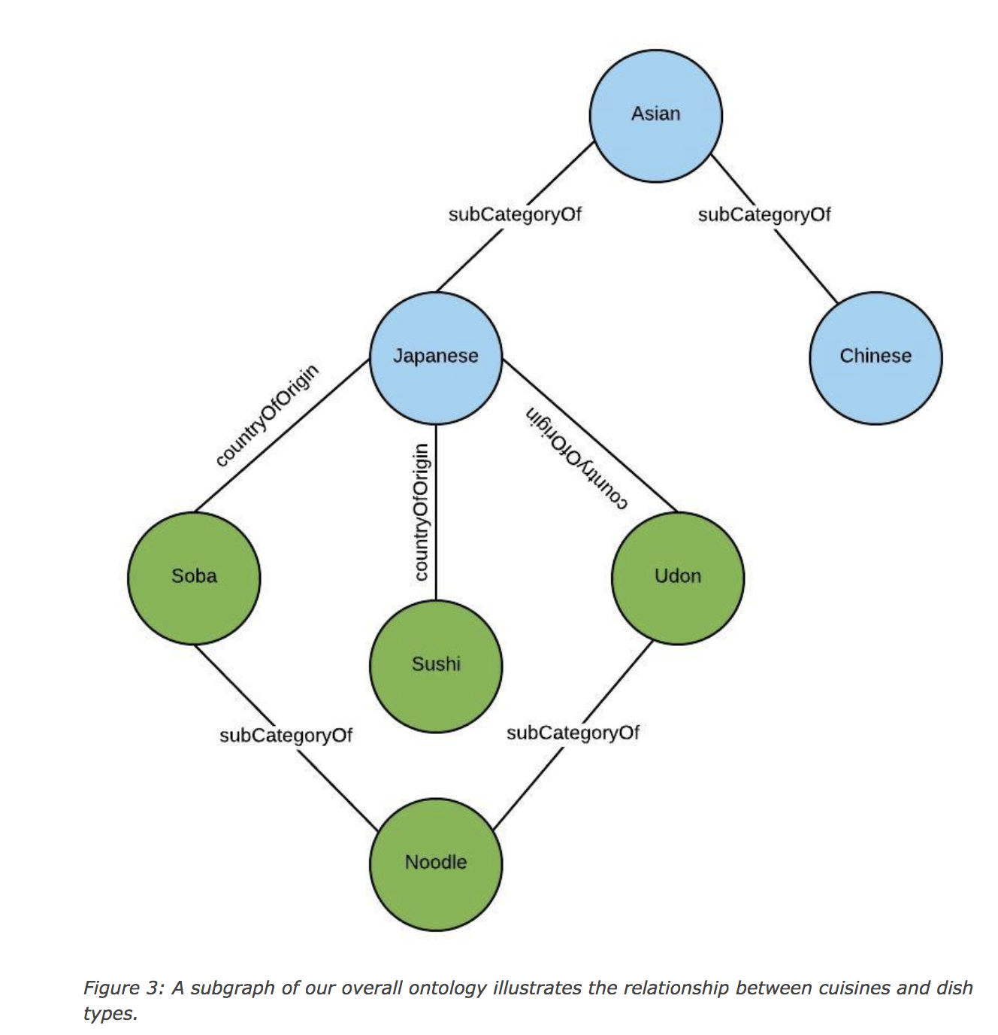
Uber Eats knowledge graph & query understanding https://eng.uber.com/uber-eats-query-understanding/

Slide 12
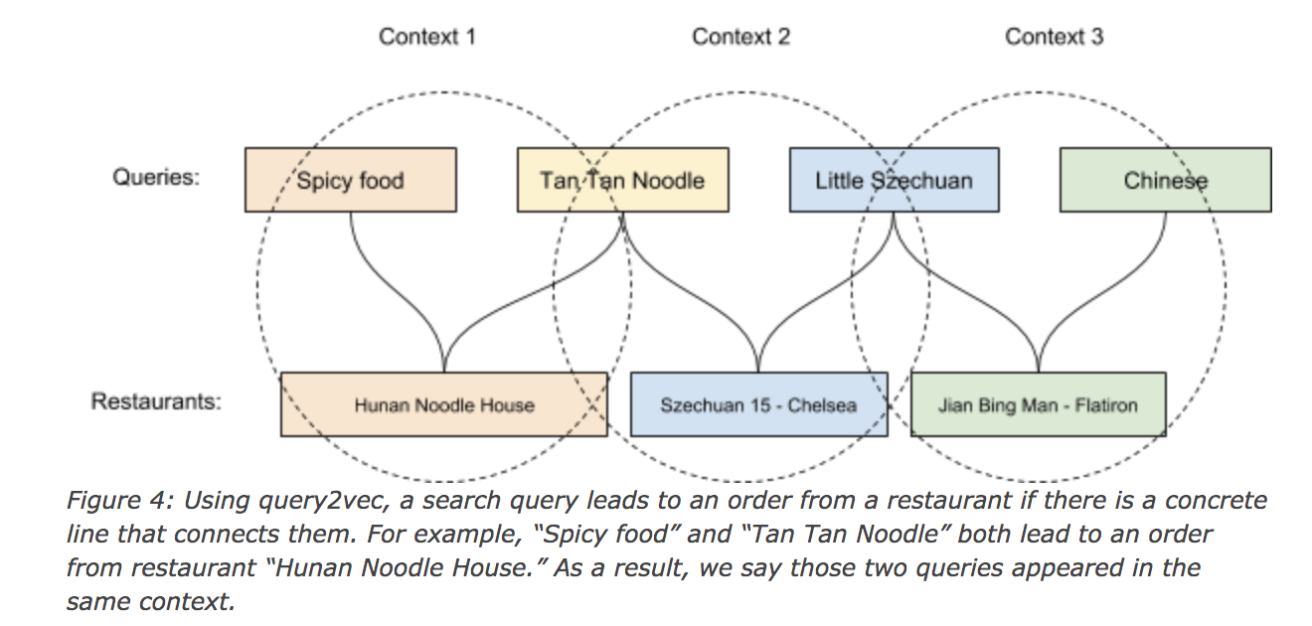
Uber Eats knowledge graph & query understanding https://eng.uber.com/uber-eats-query-understanding/

Slide 13
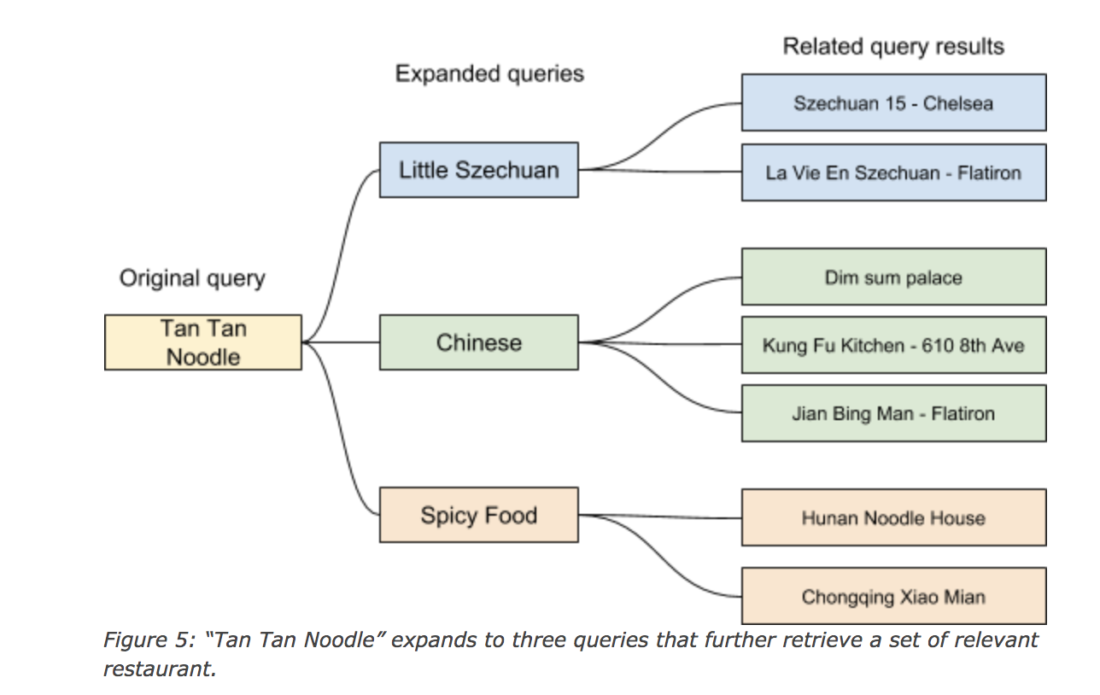
Uber Eats knowledge graph & query understanding https://eng.uber.com/uber-eats-query-understanding/

Slide 14
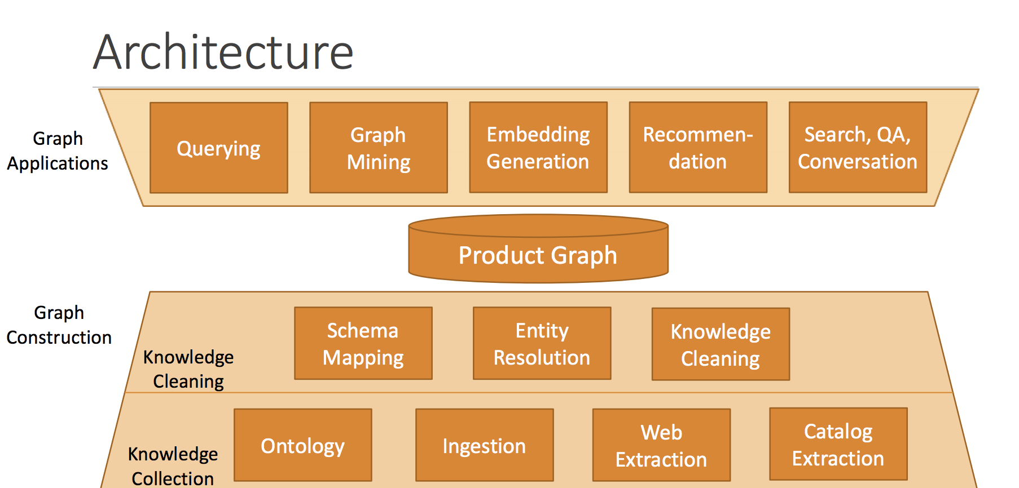
Knowledge Graph Construction

Slide 15
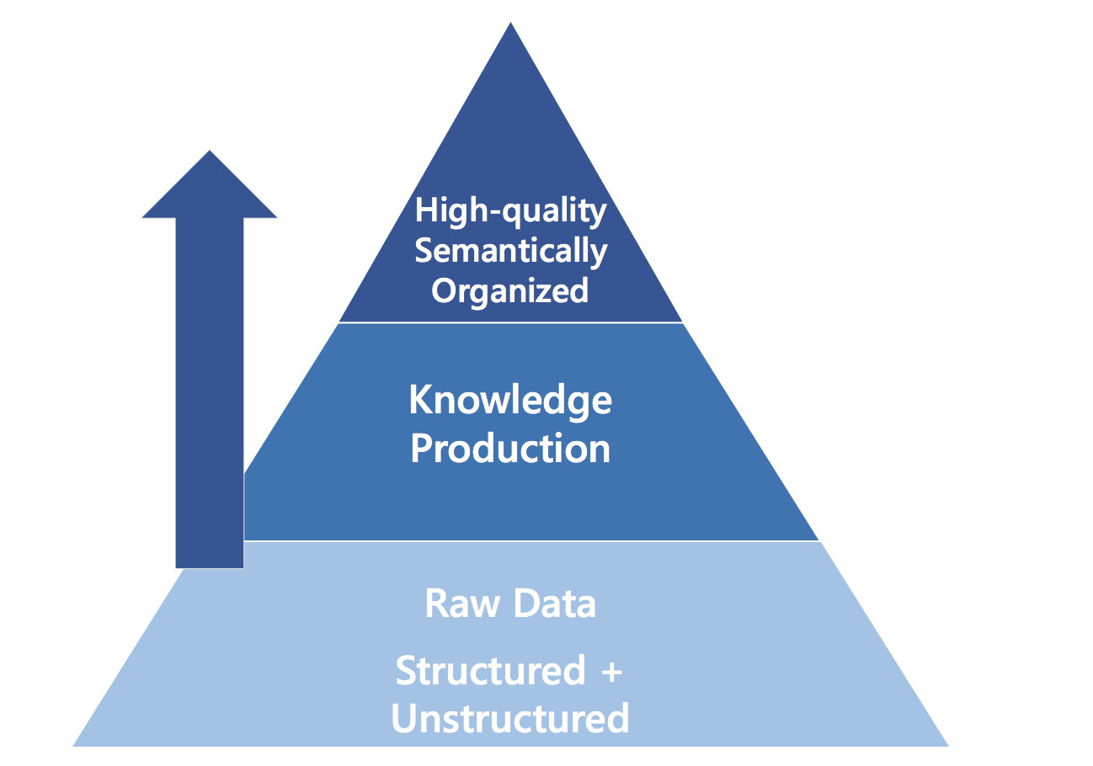
Knowledge Graph Construction

Slide 16
Knowledge Graph Construction
Ingest knowledge from structured and unstructured sources
Structured sources: relational databases, data feeds, catalogs, directories et al
Unstructured sources: Web pages, news and forums, emails, social media, catalog, speech, images, video
Web pages: extract user-designated data from web resources to structured form
Rule-based: regular expressions, wrapped programming languages
Tree-based: segment DOM into data regions, then extract with partial alignment
Machine Learning based

Slide 17
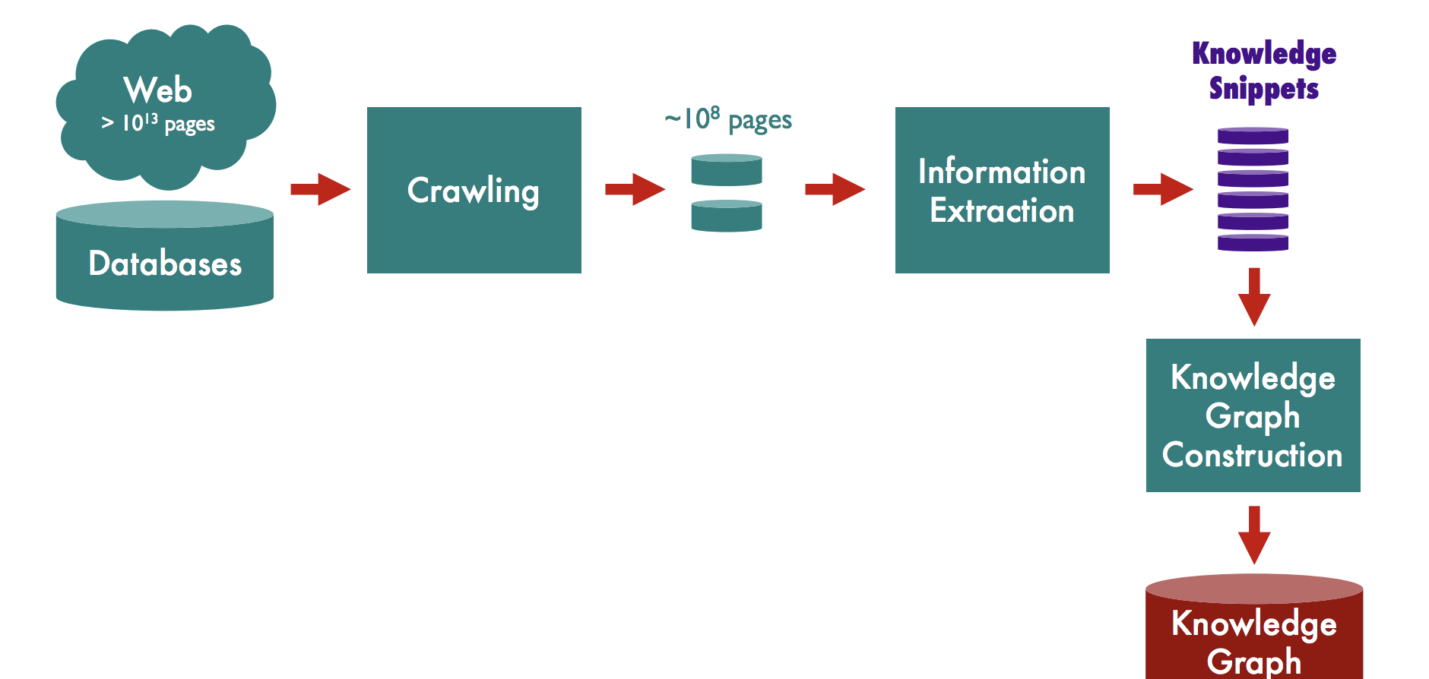
Knowledge Graph Construction
Notes:
USC KDD17 tutorial: Data Mining in Unusual Domains with Knowledge Graph Construction, Inference and Search
https://usc-isi-i2.github.io/KDD17/

Slide 18
Knowledge Graph Construction
Domain discovery: identifying relevant sites, datasets and pages
Crawling: building models of relevant content, identifying new content, overcoming anti-crawling measures
Crawling tools:
Apache Nutch (highly scalable web crawler)
Deep Dive (adaptive crawler – reinforcement learning to learn which links to follow)
ScrapingHub

Slide 19
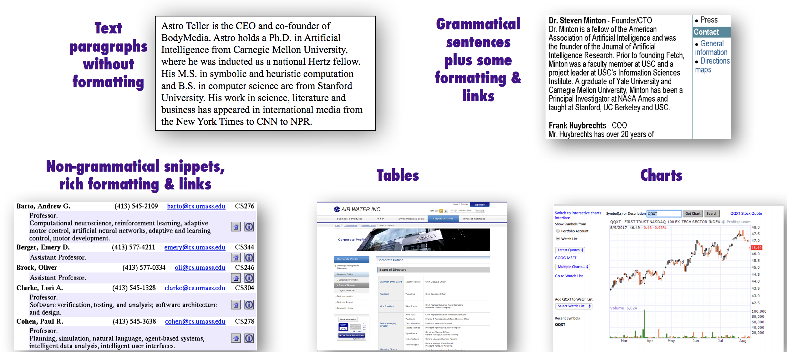
Dimensions of Information Extraction
Document features, Scope, pattern complexity, Relevance
DOCUMENT FEATURES

Slide 20
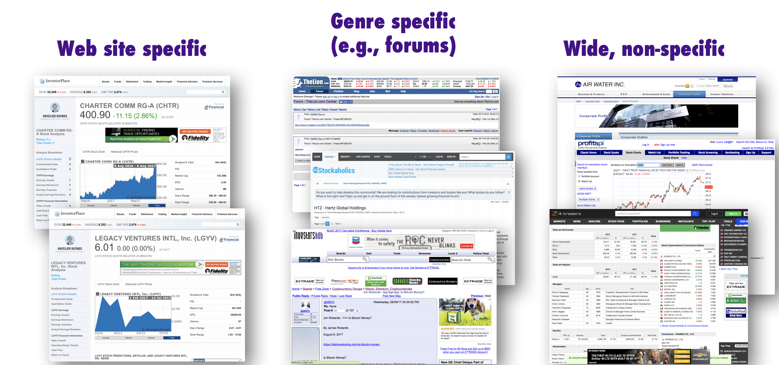
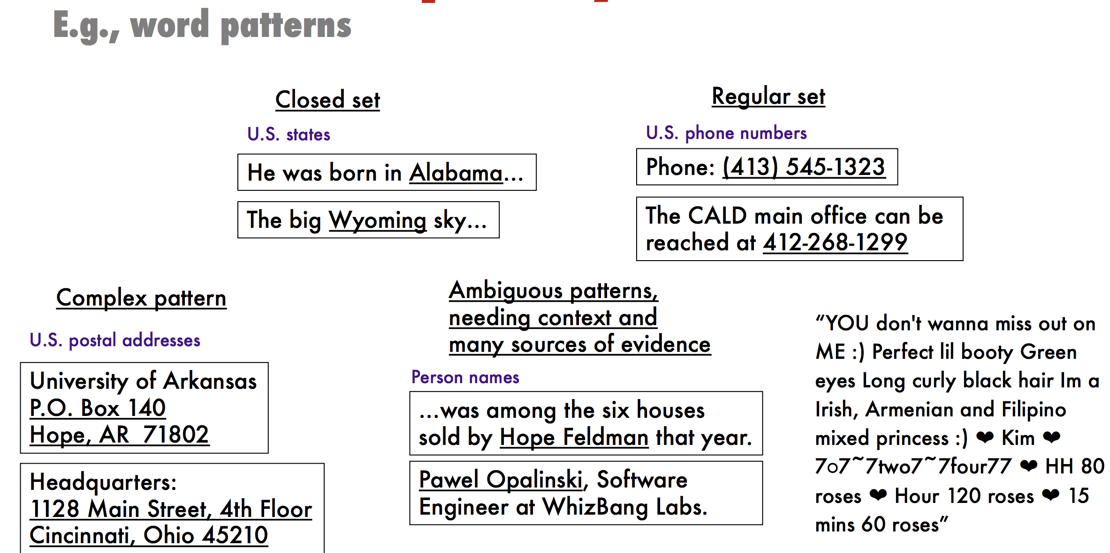
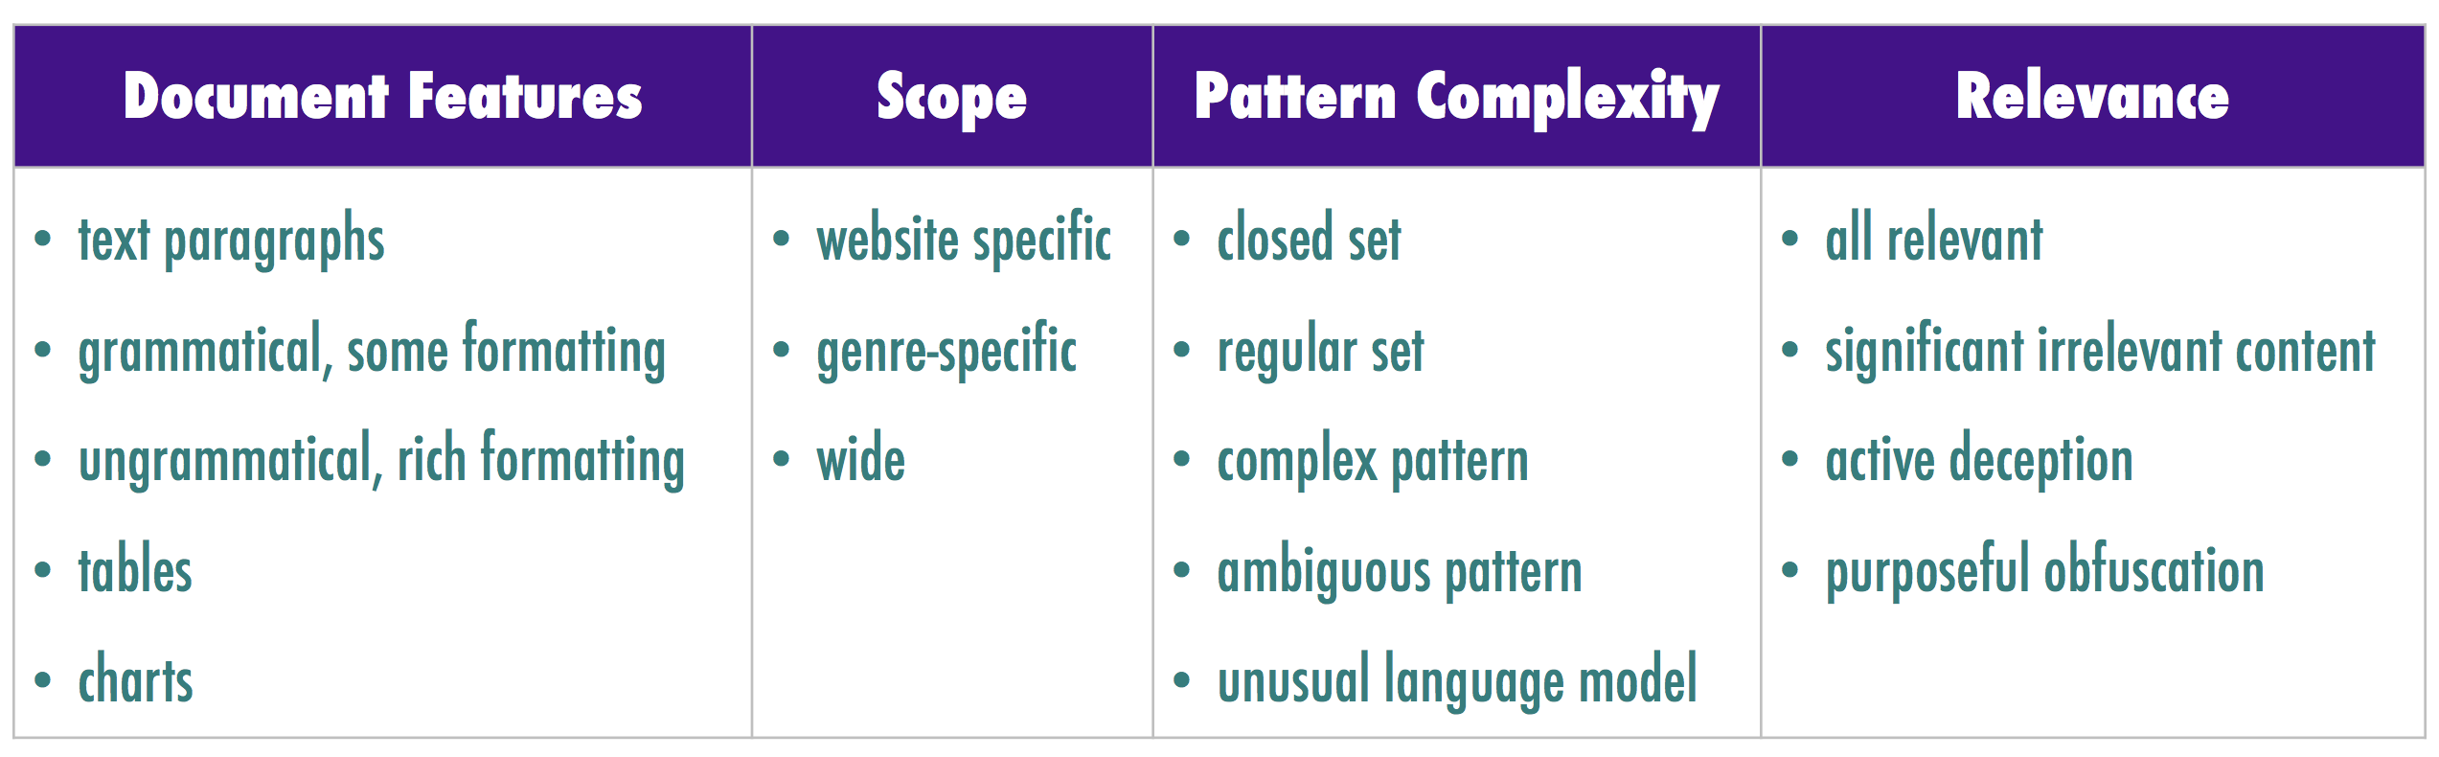
Dimensions of Information Extraction
Pattern Complexity
Scope

Slide 21
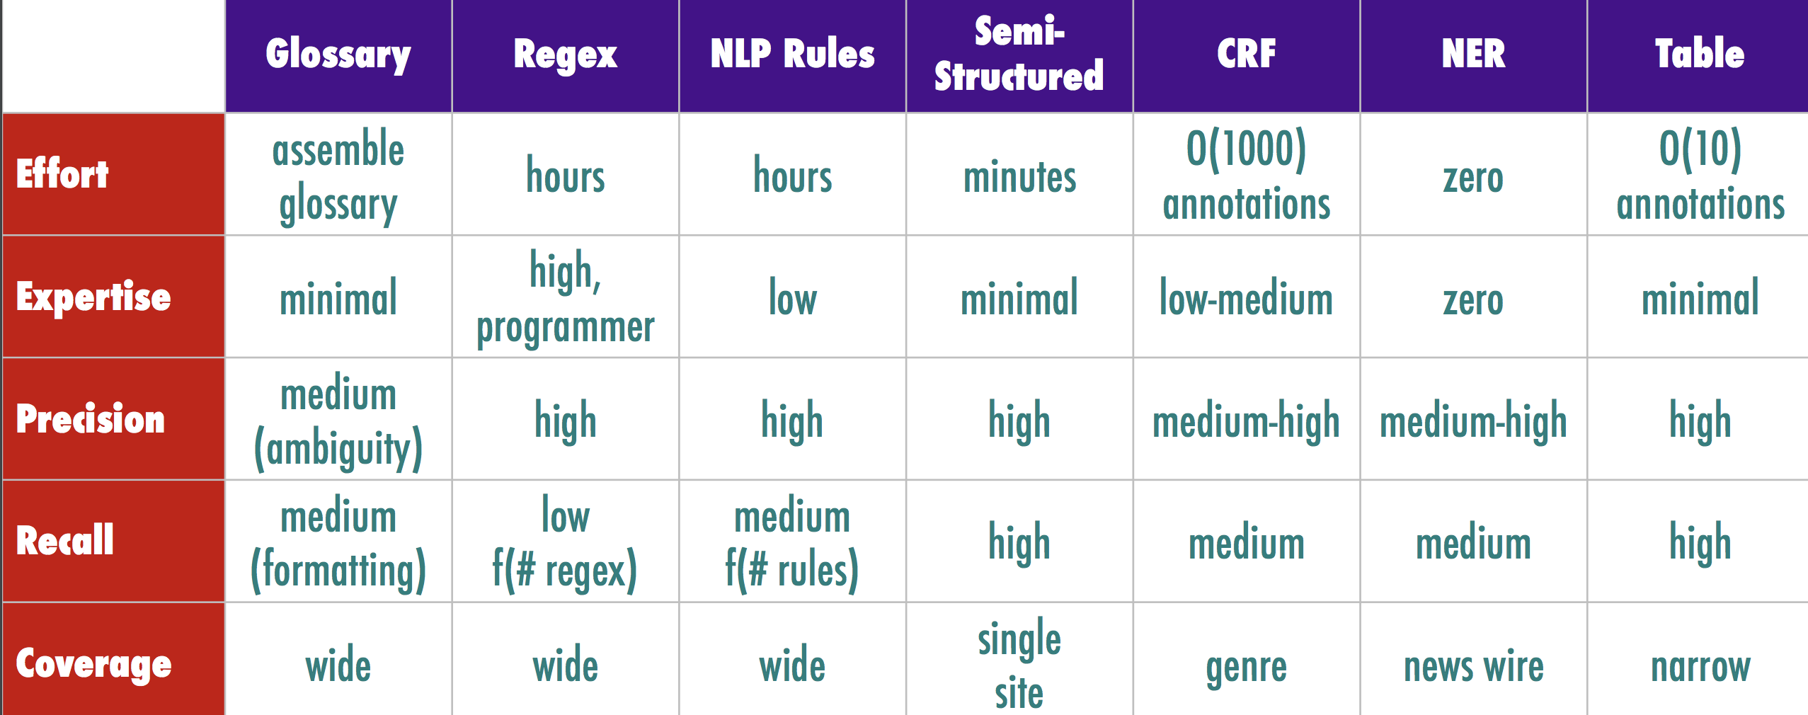
Information Extraction Technologies
High precision when showing extractions to users, and high recall when ranking results

Slide 22
Glossary Extraction
List of words and phrases to extract
Challenges:
Ambiguity: Charlotte is a name of a person and a city
Colloquial expressions: “EU Broadband, Inc.”, vs “EU Broadband”
Research:
Improving precision of glossary extractions
Extending glossaries automatically

Slide 23
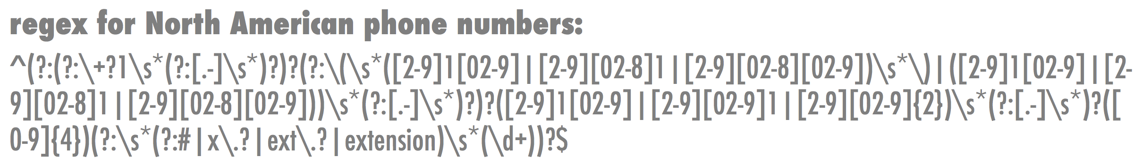
Extraction using Regular Expressions
Too difficult for non-programmars
Brittle and difficult to adapt to some domains:
Unusual nomenclature and short-hands

Slide 24
NLP rule—based extraction
Tokenization for unusual domains :
tokenize on white-space, punctuation and emojis.
Token properties:
Literal, POS, lemma, in/out of vocabulary
Dependency parsing relationships (advanced)
Type (alphanumeric, alphabetic, numeric)
Shape (pattern of digits and characters), capitalization, prefix and suffix
Pattern
Sequence of required/optional tokens, positive and negative patterns
Brittle and difficult to adapt to some domains:
Unusual nomenclature and short-hands

Slide 25
Named-Entity Recognizers
Machine Learning models (CRFs, bi-LSTM-CRF):
People, places, organizations, et al
SpaCy:
Complete NLP toolkit, Python (Cython), MIT License
Stanford NER:
part of Stanford’s NLP software library, Java, GNU license
Zalando Research: Flair NLP
Facebook PyText
Brittle and difficult to adapt to some domains:
Unusual nomenclature and short-hands

Slide 26
What did you learn today?
Questions?

